Slide 1
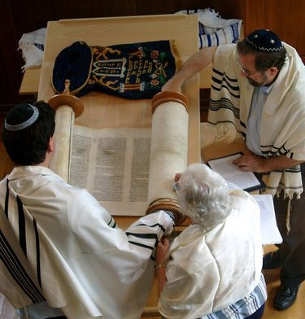
Introduction to Judaism is a pathway for the adult learner who wishes to discover or deepen Jewish knowledge. In 20 sessions we will provide a journey into Jewish spirituality, thought, ritual and culture. We will also discuss the scope of Jewish history, the meaning of Jewish peoplehood, Jewish diversity and the importance of Israel to the Jewish people.
Where and when will classes meet?
Classes will meet at area Conservative synagogues. The first five sessions will meet at Emanuel, followed by Beth El, B'nai Tikvoh Sholom and Beth Sholom B'nai Israel.
The program will meet on 21 Thursday evenings beginning on October 20, 2016. The introduction to Judaism module meets from 7:35 – 9:15 PM.
From December 1, 2016 until February 9, 2017, a beginners Hebrew reading module will be added, meeting from 6:30 -7:25 PM. (Cost will depend upon number of registrants.)
Program Fees:
$295 per participant. Significant others and full-time students will receive a 50% discount. Students who have registered for the course in prior years will receive a 30% discount.
There will be required readings. Many will be from texts you will want to acquire. Some readings will be provided as handouts.
There will be an additional fee for the Hebrew reading module based on the number of students.
Special arrangements may be made for reasons of financial need. Contact Rabbi Plavin to discuss your need confidentially.
The Institute for Basic Judaism
2016-2017
An Introduction to Judaism Program serving Central Connecticut
Offered in partnership with the Miller Introduction to Judaism Program at American Jewish University
The Institute for Basic Judaism
For more information contact Rabbi Richard Plavin, Director (860) 573-4503
riplavin@gmail.com
This program is endorsed by the Rabbinical Assembly
of Greater Hartford
www.ibjewish.org

Slide 2
“Observing Mitzvot (commandments) is the primary way Jews live a religious life. We express our search for God and our quest to live in holiness through the observance of Mitzvot. The Mitzvot inspire us by focusing our thoughts and elevating our feelings: they guide us toward behavior imbued with certain values and goals. The observance of Mitzvot shapes our actions and sanctifies our behavior. We make ourselves open to the spirit through the act of fulfilling Mitzvot.”
-Rabbi Pamela Barmash
The study of Mitzvot is the major focus of IBJ.
You will learn about:
From past participants:
History and culture of the Jewish people
Holy days and festivals
Sabbath
Passover
Jewish concepts of God and ethics
Synagogue and its services
Life cycle observances including: birth bar & bat mitzvah marriage death
Kashrut: the Jewish dietary laws
Anti-Semitism and the Holocaust
Israel and Zionism
Diversity of contemporary Jewish life
“
I found The Basic Judaism class with Rabbi Plavin to be very informative and easy to follow. I particularly enjoyed the way he pulled our class together like the new family we were beginning to form.
I found the class and Rabbi Plavin to be warm and inviting to new comers as well as patient and kind. I found him to be extremely tolerant and accepting of people and their beliefs. Through this class I found myself falling in love with Judaism.
Thank you so much for facilitating the wonderful class....It was truly a once-in-a-lifetime learning experience. ..I couldn't have asked for a better teacher or better introduction to this religion I have chosen!
“
“
Who are our students?
“
The Institute provides educational background for all seeking to learn about Judaism, including:
Jews who never had the opportunity of a Jewish education in their youth.
Prospective Jews-by-Choice who need to meet the academic requirements of conversion to Judaism.
Individuals who want to better understand the religion of their significant other or a family member.
Non-Jews who may have an intellectual curiosity about the mother faith of both Christianity and Islam.

